Slide 1
Functions II
Recursion

Slide 2
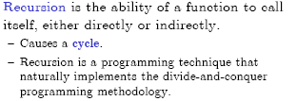
What is recursion?

Slide 3
Recursion
Recursive functions
  Functions that call themselves
  Can only solve a base case
  Divide a problem up into
    What it can do
    What it cannot do
      What it cannot do resembles original problem
      The function launches a new copy of itself (recursion step) to solve what it cannot do
  Eventually base case gets solved
    Gets plugged in, works its way up and solves whole problem

Slide 4
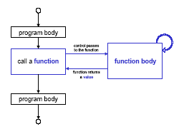
How does a recursion works?

Slide 5
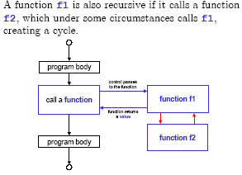
What is recursion?

Slide 6
Recursive Functions Factorial
A simple example of a recursively defined function is the factorial function:
n! = 1· 2· 3· 4 ···(n –2)·(n –1)·n
i.e., the product of the first n positive numbers (by convention, the product of nothing is 1, so that 0! = 1).
Q: Find a recursive definition for n!

Slide 7
Recursive Functions Factorial
A:INITIALIZATION: 0!= 1
RECURSION: n != n · (n -1)!
To compute the value of a recursive function, e.g. 5!, one plugs into the recursive definition obtaining expressions involving lower and lower values of the function, until arriving at the base case.
EG: 5! = 5 · 4! = 5 · 4 · 3! = 5 · 4 · 3 · 2!
recursion

Slide 8
Recursive program-Factorial
Following is the recursive version of the function to calculate the factorial value.
main( )
{
int a, fact ;
printf ( "\nEnter any number " ) ;
scanf ( "%d", &a ) ;
fact = rec ( a ) ;
printf ( "Factorial value = %d", fact ) ;
}
int rec ( int x )
{
int f ;
if ( x == 1 )
return ( 1 ) ;
else
f = x * rec ( x - 1 ) ;
return ( f ) ;
}

Slide 9
In the first run when the number entered through scanf( ) is 1, let us see what action does rec( ) take. The value of a (i.e. 1) is copied into x.
Since x turns out to be 1 the condition if ( x == 1 ) is satisfied and hence 1 (which indeed is the value of 1 factorial) is returned through the return statement.
When the number entered through scanf( ) is 2, the ( x == 1 ) test fails, so we reach the statement,
f = x * rec ( x - 1 ) ;
And here is where we meet recursion. How do we handle the expression x * rec ( x - 1 )? We multiply x by rec ( x - 1 ). Since the current value of x is 2, it is same as saying that we must calculate the value (2 * rec ( 1 )). We know that the value returned by rec ( 1 ) is 1, so the expression reduces to (2 * 1), or simply 2. Thus the statement,
x * rec ( x - 1 ) ;
evaluates to 2, which is stored in the variable f, and is returned to main( ), where it is duly printed as
Factorial value = 2

Slide 10
Factorial using Recursion
rec ( 5 ) returns ( 5 times rec ( 4 ),
which returns ( 4 times rec ( 3 ),
which returns ( 3 times rec ( 2 ),
which returns ( 2 times rec ( 1 ),
which returns ( 1 ) ) ) ) )

Slide 11
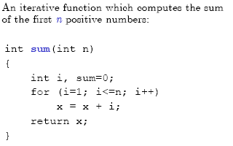
Iteration vs. recursion

Slide 12
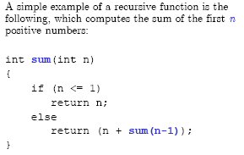
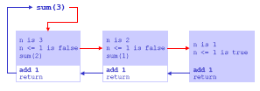
Recursion: sum()

Slide 13
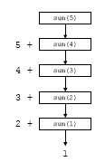
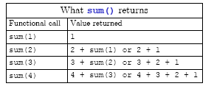
Recursion: sum()

Slide 14
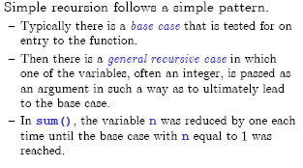
How does recursion work?

Slide 15
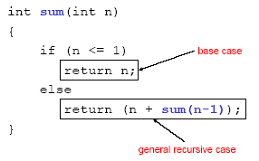
How does recursion work?

Slide 16
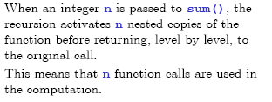
How does recursion work?

Slide 17
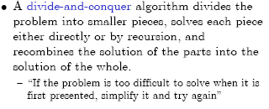
Divide-and-conquer

Slide 18
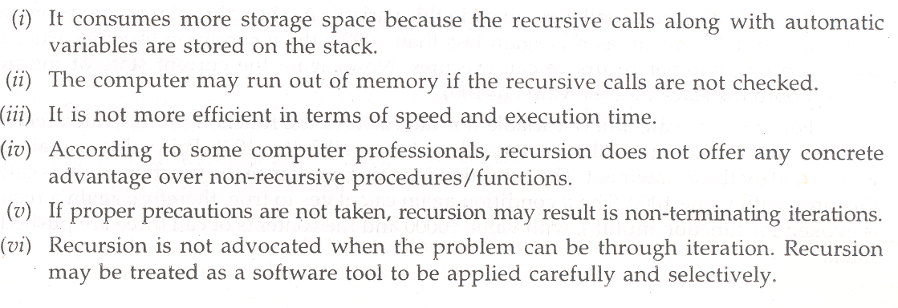
Disadvantages of recursion

Slide 19
Examples on Recursion

Slide 20
Recursion - Example
Fibonacci Sequence
1, 1, 2, 3, 5, 8, 13, 21, …
1st 2nd 3rd 4th 5th 6th 7th 8th
  Let us call the 1st Fibonacci number, Fib(1), the 2nd Fib(2)… This gives us n.
  Fib(1) = 1 defined base case
  Fib(2) = 1 defined base case
  Fib(3) = 2 = 1 + 1
      = Fib(2) + Fib(1)
  Fib(7) = 13 = 8 + 5
      = Fib(6) + Fib(5)
Fibonacci Algorithm using Recursion
  int Fib (int n)
  {
  int temp = 1; /* handles base cases */
  if (n > 2)
  temp = Fib(n-1) + Fib(n-2);
  return temp;
  }

Slide 21
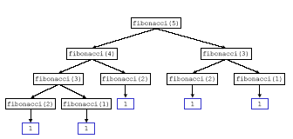
Fibonacci series

Slide 22
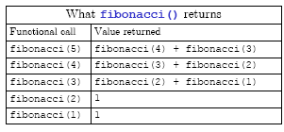
Fibonacci series

Slide 23
Example Using Recursion: The Fibonacci Series
Fibonacci series: 0, 1, 1, 2, 3, 5, 8...
  Each number is the sum of the previous two
  Can be solved recursively:
    fib( n ) = fib( n - 1 ) + fib( n – 2 )
  Code for the fibaonacci function
    long fibonacci( long n )
    {
    if (n == 0 || n == 1) // base case
    return n;
    else
    return fibonacci( n - 1) +
    fibonacci( n – 2 );
    }

Slide 24
Example Using Recursion: The Fibonacci Series
Set of recursive calls to function fibonacci
f( 3 )
return
f( 2 )
+
f( 1 )
return
f( 1 )
+
f( 0 )
return 1
return 1
return 0

Slide 25
1. Function prototype
1.1 Initialize variables
2. Input an integer
2.1 Call function fibonacci
2.2 Output results.
3. Define fibonacci recursively
Program Output
/* Recursive fibonacci function */
long fibonacci( long );
main()
{
long result, number;
printf( "Enter an integer: " );
scanf( "%ld", &number );
result = fibonacci( number );
printf( "Fibonacci( %ld ) = %ld\n", number, result );
}
/* Recursive definition of function fibonacci */
long fibonacci( long n )
{
if ( n == 0 || n == 1 )
return n;
else
return fibonacci( n - 1 ) + fibonacci( n - 2 );
}

Slide 26
Enter an integer: 0
Fibonacci(0) = 0
Enter an integer: 1
Fibonacci(1) = 1
Program Output
Enter an integer: 2
Fibonacci(2) = 1
Enter an integer: 3
Fibonacci(3) = 2
Enter an integer: 4
Fibonacci(4) = 3
Enter an integer: 5
Fibonacci(5) = 5
Enter an integer: 6
Fibonacci(6) = 8
Enter an integer: 10
Fibonacci(10) = 55
Enter an integer: 20
Fibonacci(20) = 6765
Enter an integer: 30
Fibonacci(30) = 832040
Enter an integer: 35
Fibonacci(35) = 9227465

Slide 27
Reverse - function with recursion
int reverse(int x)
{
static int r=0, b=1;
if(x==0)
return(0);
else
{
r=x%10*b + reverse(x/10);
b=b*10;
}
return(r);
}
main()
{
int n;
scanf("%d",&n);
printf("%d",reverse(n));
}

Slide 28
Reverse - function with recursion
(an alternate solution)
int rev(int, int);
void main()
{
int num, result;
int length = 0, temp;
printf("Enter an integer number to reverse: ");
scanf("%d", &num);
temp = num;
while (temp != 0)
{
length++;
temp = temp / 10;
}
result = rev(num, length);
printf("The reverse of %d is %d.\n", num, result);
}
int rev(int num, int len)
{
if (len == 1)
{
return num;
}
else
{
return (((num % 10) * pow(10, len - 1)) + rev(num / 10, --len));
}
}

Slide 29
HCF/GCD - function with recursion
int hcf(int n1, int n2);
void main()
{
int n1, n2;
printf("Enter two positive integers: ");
scanf("%d%d", &n1, &n2);
printf("H.C.F of %d and %d = %d", n1, n2, hcf(n1,n2));
}
int hcf(int n1, int n2)
{
if (n2!=0)
return hcf(n2, n1%n2);
else
return n1;
}

